Slide 1
Advanced Debug of the Framework
Henry Li
Insyde Software Corp.
July, 2004

Slide 2
Agenda
InsydeH₂O Debugger introduction
Scenario 1 – Memory init problem
Scenario 2 – Driver does not get dispatched
Scenario 3 – Problem with the CSM that cause a problem with the Windows OS.

Slide 3
InsydeH₂O Debugger Overview
Pure software debugger for InsydeH₂O™
  USB 2.0 interface
  Debug both PEI and DXE
  Source level debugger
  Host Debug software works on Windows 2000 and XP
System requirement
  The target platform firmware contains the “InsydeH₂O Debugger module” to take the command and return data of debug software
  Target platform needs USB 2.0 debug port

Slide 4
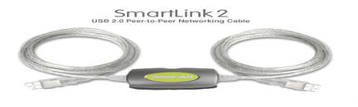
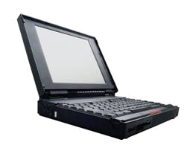

InsydeH₂O Debugger Connection
Special USB 2.0 cable
Common USB 2.0 port
USB 2.0 Debug Port

Slide 5
InsydeH₂O Debugger Features
Source level debugger including PEI and DXE
Different windows for read/write/save/load register values
  I/O, Memory, CMOS, PCI, CPU Registers
Skip inaccessible region while reading a block of data
Lock/unlock feature
  Reading SIO registers
Customizable user’s interface with dock/tab capability
Hot-keys and command line support
Other useful features

Slide 6
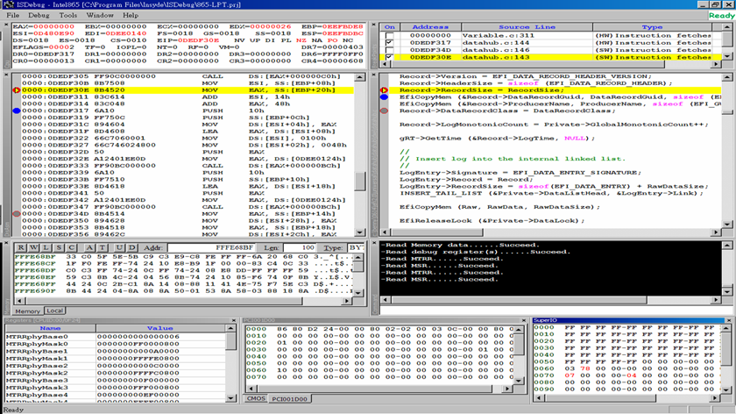
InsydeH₂O Debugger Screen Shot

Slide 7
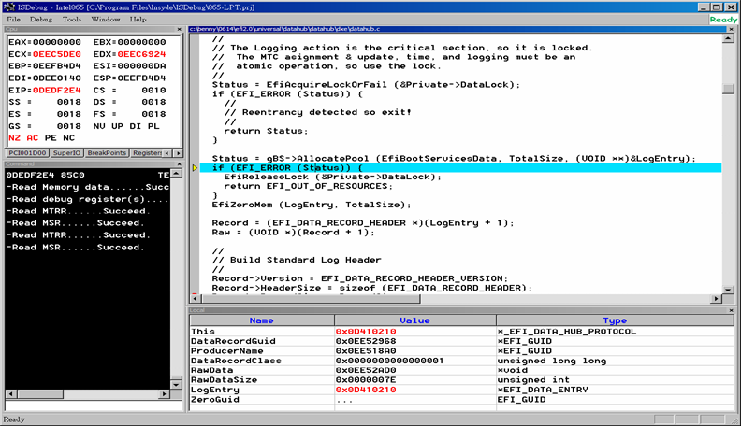
C Source code & Variables Window

Slide 8
What can not be debugged?
Hardware problems
  The first BIOS instruction code does not execute
  Interfacing problem, CPU-HOST bridge, FWH-BRIDGES
The framework’s core and the code before InsydeH₂O Debugger is loaded
  PEI CORE
  DXE CORE
Use American Arium debug utility for above scenarios
  ECM50 plus SourcePoint 7.0

Slide 9
Agenda
Insyde Debugger introduction
Scenario 1 – Memory init problem
Scenario 2 – Driver does not get dispatched
Scenario 3 – Problem with the CSM that cause a problem with the Windows OS.

Slide 10
Where the System Memory is Needed?
Exposed
Platform
Interface
Pre Verifier
OS-Absent
App
CPU
Init
verify
Chipset Init
Transient OS Environment
Device, Bus, or Service Driver
Board Init
Transient OS Boot Loader
EFI Driver Dispatcher
Boot Manager
OS-Present
App
Intrinsic Services
Final OS Boot Loader
Final OS Environment
?
security
Security (SEC)
Pre EFI
Initialization (PEI)
Driver Execution Environment (DXE)
Boot Dev
Select
(BDS)
Transient
System Load
(TSL)
Run Time
(RT)
After Life
(AL)
Power on
[ . . Platform initialization . . ]
[ . . . . OS boot . . . . ]
Shutdown

Slide 11
What happens if system memory is not available?
What happens if memory is not available?
  A hang some where in PEI
  DXE not dispatched
  Failed to create stack in system memory
  System reset all the time
The problem could be for example:
  Reading wrong SPD data
  Clock generator program incorrectly
  Memory initialize incomplete, some steps of memory size could be wrong.
  PEI missed that Initialized ECC memory

Slide 12
Debug Tools and Methods
Source level debug with InsydeH₂O Debugger
Check the register setting with SPD data
Enable post code breaks to reach the code causes system to hang.

Slide 13
Case Study – Debug the memory size incorrect problem
Note:
Do a real debug demo here
Break the H2P driver and debug it by using InsydeH₂O Debugger
Program DRA, DRB register incorrectly
Solve and fix problem and re-flash the BIOS
~ 30 minutes
This slide is for speaker only

Slide 14
Memory Debug Summary
Using Serial port dump, system hanged somewhere in PEI.
Single stepping using Insyde debugger shows it hangs after DualChannelDdrMemoryInit driver.
Cause: the wrong value from the SPB table was programmed into SPB.
Correct value is looked up in the table.
Source is corrected, re-flashed.

Slide 15
Agenda
Insyde Debugger introduction
Scenario 1 – Memory init problem
Scenario 2 – Driver does not get dispatched
Scenario 3 – Problem with the CSM that cause a problem with the Windows OS.

Slide 16
Where the driver get dispatched?
Exposed
Platform
Interface
Pre Verifier
OS-Absent
App
CPU
Init
verify
Chipset Init
Transient OS Environment
Device, Bus, or Service Driver
Board Init
Transient OS Boot Loader
EFI Driver Dispatcher
Boot Manager
OS-Present
App
Intrinsic Services
Final OS Boot Loader
Final OS Environment
?
security
Security (SEC)
Pre EFI
Initialization (PEI)
Driver Execution Environment (DXE)
Boot Dev
Select
(BDS)
Transient
System Load
(TSL)
Run Time
(RT)
After Life
(AL)
Power on
[ . . Platform initialization . . ]
[ . . . . OS boot . . . . ]
Shutdown

Slide 17
What happens if driver not get dispatched?
What happens if driver not get dispatched?
  Other dependant drivers do not get dispatched
  Driver not connecting to controller
  A hang somewhere in DXE
The problem could be for example:
  Manual dependency checks (*.dxs file in source tree)
  Driver is dependant on another driver that did not get dispatched
  Device IDs match the hardware?
  Driver has a coding problem?

Slide 18
Debug Tools and Methods
Source level debug with InsydeH₂O Debugger
Shell commands
DXE Core update to dump DXE drivers not dispatched
DXE Core update to dump Arch Protocols not installed

Slide 19
Case Study – Debug the AC97 driver not loaded
Note:
Develop a EFI application to use specific driver to accomplish enable/disable AC97 device
Write a EFI driver to enable/disable the AC97 from ICH registers
Put some error code in the AC97 device driver, ex: incorrect Ids
Solve and fix problem and re-flash the BIOS
~ 30 minutes
This slide is for speaker only

Slide 20
Debug Summary
System hangs somewhere in DXE.
Arium shows that hang is caused by a jmp $ in AC97 driver’s Supported function.
Correct and soft load the corrected file.
Driver no longer hangs but still is not connecting to device.
Step through AC97 driver again: Device ID is incorrect.
Correct and soft load—driver functional.
Re-flash the Firmware with corrected code.

Slide 21
Agenda
Insyde Debugger introduction
Scenario 1 – Memory init problem
Scenario 2 – Driver does not get dispatched
Scenario 3 – Problem with the CSM that cause a problem with the Windows OS.

Slide 22
What happens while booting OS if the CSM does not work properly?
System won’t boot
A hang somewhere in windows init
Blue screen dump
Yellow bangs in device manager
Incorrect amount of memory is reported

Slide 23
The problem could be
BIOS reports incorrect amount of memory
ACPI Tables incorrect
Interrupt routing does not match the hardware design
Incorrect APIC IDs

Slide 24
Debug Tools and Methods
DOS utility to dump E820 memory map
Investigate interrupt routing tables in legacy BIOS platform driver
Check ASL code for errors

Slide 25
Case Study – Debug PCI-IDE card does not work problem
Note:
Put some error code in the legacy platform driver to make the interrupt routing incorrect
Apply a PCI-IDE card with IDE hard drive attached to the target platform
Debug the problem of failing to boot from the mentioned hard driver
Solve and fix problem and re-flash the BIOS
~ 30 minutes
This slide is for speaker only

Slide 26
Debug Summary
System can not boot from PCI SCSI hard drive, but can boot from other devices.
Debugger: Hangs when about to load boot code.
Checked: E820 Memory Map, ACPI Table, PIRQ Routing Table
Error found in PIRQ table.
Correct table and reflash.

